Slide 1




Git Usage
Presented by
Kyaw Zin Thant

Slide 2

What is Git and Why used it for?
Git is a DevOps tool used for source code management. It is a free and open-source version control system used to handle small to very large projects efficiently. Git is used to tracking changes in the source code, enabling multiple developers to work together on development.

Slide 3
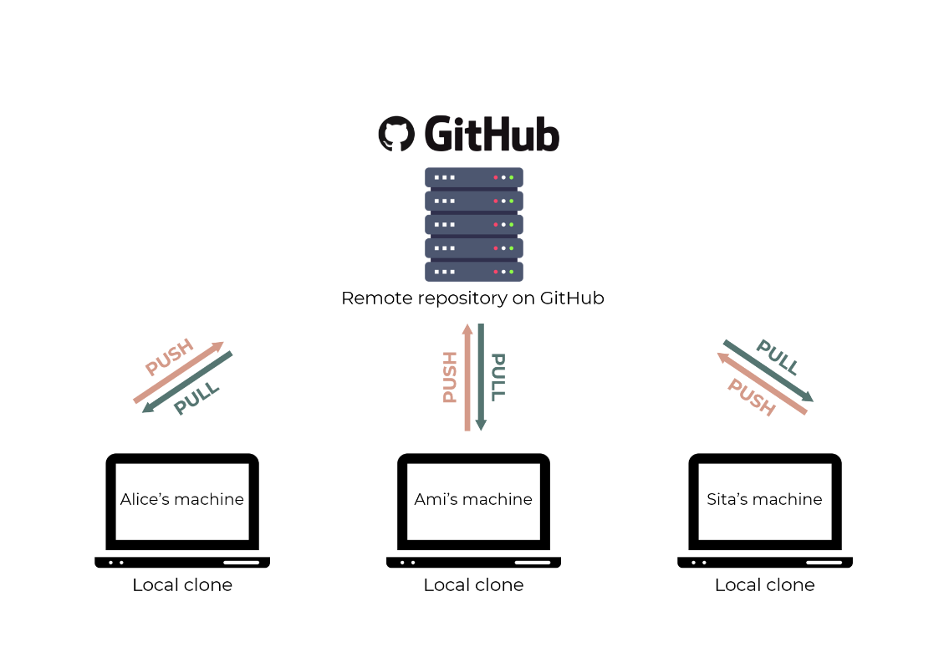

Slide 4
Initial Git configuration
git config --global user.name “Kyaw Zin"
git config --global user.email kyawzinucsm89@gmail.com
I will share git commands next slide

Slide 5
git init
Start tracking a project in Git.
This command creates the .git directory.
if you are using git locally only
if it's not on a remote (yet)
simplest way is typically creating a repo on git, bitbucket, etc and then cloning

Slide 6
git status
Show the status of modified files in the working directory.
These can be untracked, unstaged or staged for commit.

Slide 7
git add <files> || .
Copy snapshots of modified files to the staging area.
This command tracks new files

Slide 8
git commit
Save a snapshot of the staging area to the history as a commit.
Git commit is what will push changes from the staging area, to the history. The workflow for git is
working directory
staging
committing to history.

Slide 9
git checkout -- <files> || .
Omit <files> to throw away all local changes.

Slide 10
git diff
See the exact lines added and removed in the working directory.

Slide 11
git log
Browse and inspect the evolution of the project.

Slide 12
git remote add origin <url>
Add a remote git repository

Slide 13
git fetch
Get all the data from the remote repository unto your local disk.

Slide 14
git push origin <branch>

Slide 15
git checkout -b <branchname>
Create new branch from current branch

Slide 16
git merge <branchname>
Merge code into branch

